Slide 1
Topic 7
Greedy Technique
Prof. Hanan Elazhary
Main source: A. Levitin, Introduction to the Design and Analysis of Algorithms, 3rd edition

Slide 2
Greedy Technique
An algorithm design strategy that constructs a solution to an optimization problem piece by piece through a sequence of choices that are
feasible, i.e., satisfying the constraints
locally optimal (with respect to some neighborhood definition)
irrevocable (permanent)
For some problems, it yields a globally optimal solution for every instance (we are mostly interested in this case)
For most cases, it does not but can be useful for fast approximations
problem defined by an objective function and a set of constraints

Slide 3
Greedy Technique, Contd.
Optimal solutions
change making problem (for ‘normal’ coin denominations)
minimum spanning tree (MST) (e.g., Prim’s MST Algorithm)
single-source shortest paths problem (e.g., Dijkstra’s single-source Shortest Paths Algorithm)
simple scheduling problems
coding problem (e.g., Huffman codes)
Approximations/heuristics
traveling salesman problem (TSP)
knapsack problem
other combinatorial optimization problems
In the knapsack problem for example we could
a) pick the items in order determined by the highest value
b) pick the items in order determined by the highest value/weight ratio
c) pick the items in order determined by the minimum weight
but will most probably get an approximate solution

Slide 4
Change-Making Problem
Required change of a specific amount n with the least number out of unlimited number of coins of normal denominations d₁>d₂ > . . .>d_{m}
For example, considering the widely used coin denominations in the US
d₁ = 25 (quarter), d₂ = 10 (dime), d₃ = 5 (nickel), and d₄ = 1 (penny)
how would you give 48 cent change with the least number of these denominations?
Greedy solution starts with the largest: 1 quarter, 2 dimes, and 3 pennies =6 coins are used
Greedy solution
is optimal for any amount and ‘normal’ set of denominations (can you prove it?)
may not be optimal for arbitrary coin denominations
feasible, locally optimal, irrevocable
For example, d1 = 25c , d2 = 10c, d3 = 1c, and n = 30c
https://math.stackexchange.com/questions/2433735/proving-that-greedy-coin-change-algorithm-gives-optimal-solution-under-certain-c
Notes:
Objective Function: Minimize the number of coins used to make a specific amount.
Constraints:
The total value of the chosen coins must equal the target amount.
Only denominations available in the set (e.g., quarters, dimes, nickels, pennies) can be used.
For each denomination, the count of each coin is unlimited.
For normal coin denominations
For example, considering the widely used coin denominations in the US for 48 cents
d₁ = 25 (quarter), d₂ = 10 (dime), d₃ = 5 (nickel), and d₄ = 1 (penny)
Greedy solution starts with the largest: 1 quarter, 2 dimes, and 3 pennies =6 coins are used (Optimal solution)
For not normal coin denominations (arbitrary coin denominations)
For example, considering the widely used coin denominations in the US for 30 cents
d₁ = 25 (quarter), d₂ = 10 (dime), d₃ = 1 (penny)
Greedy solution starts with the largest: 1 quarter, and 5 pennies =6 coins are used (not Optimal solution)
The optimal solution would be: 10+10+10=30 (using 3 dime)
The greedy approach fails because it prioritizes the highest denomination without considering that using a lower denomination multiple times (3 dimes in this case)

Slide 5
Minimum Spanning Tree (MST)
Spanning tree of an undirected connected graph G
connected acyclic subgraph (tree) of G that includes all of G’s vertices
Minimum spanning tree of a weighted undirected connected graph G
spanning tree of G of the minimum total weight
T2 and T3 are spanning trees of T1
6
c
6
c
c
a
a
a
4
1
4
1
1
2
2
d
d
d
b
3
b
b
3

Slide 6
Prim’s MST Algorithm
Prim’s algorithm constructs a minimum spanning tree
The idea of Prim’s algorithm is
to start with a tree T formed of any single vertex
and continuously attach to it a fringe vertex such that the edge connecting it to the tree has minimum weight among all candidates,
until all vertices are exhausted
you end up with a minimum spanning tree
It always ends up with a minimum spanning tree (a theorem with a relatively long proof ☺)
a fringe is a vertex that is not in the tree but adjacent to at least one tree vertex

Slide 7
Prim’s MST Algorithm, Contd.
In fact, Prim’s algorithm
processes a sequence of expanding trees T₁, T₂, … , T_{i}, … , T_{n}
such that on each iteration, it constructs T_{i+1} from T_{i} by adding a vertex not in T_{i} and is closest to those already in T_{i} (this is a “greedy” step!)
and stops when all vertices are included
Notes:
Objective Function: Minimize the total weight of the edges included in the spanning tree.
Constraints:
The resulting graph must be a single connected tree that spans all vertices.
Only edges present in the original graph can be selected.
Cycles cannot be formed in the spanning tree (no loops).

Slide 8
Prim’s MST Algorithm, Contd.
Example
4
c
4
c
4
c
a
a
a
1
1
1
6
6
6
2
2
2
d
d
d
b
3
b
3
b
3
4
c
4
c
a
a
1
1
6
6
2
2
d
d
b
3
b
3
8

Slide 9
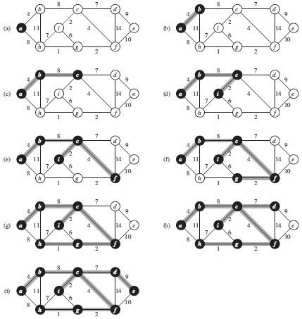
Prim’s MST Algorithm, Contd.
Example
9

Slide 10
Prim’s MST Algorithm, Contd.
Proof by induction that this construction actually yields a MST
The Crucial Property behind Prim’s Algorithm
Claim: Let G = (V,E) be a weighted graph and (X,Y) be a partition of V (called a cut). Suppose e = (x,y) is an edge of E across the cut, where x is in X and y is in Y, and e has the minimum weight among all such crossing edges (called a light edge). Then there is a MST containing e.
Y
y
x
X
https://gtl.csa.iisc.ac.in/dsa/node183.html
Notes:
A cut of a connected graph is a minimal set of edges whose removal separate the graph into two components (pieces). The minimal cut property says that if one of the edges of the cut has weight smaller than any other edge in the cut then it is in the MST.
To see this, assume that there is an MST not containing the edge. If we add the edge to the MST, we get a cycle that crosses the cut at least twice, so we can break the cycle by removing the other edge from the MST, thereby making a new tree with smaller weight, thereby contradicting the minimality of the MST.

Slide 11
Prim’s MST Algorithm, Contd.
Needs priority queue for locating closest fringe vertex. The Detailed algorithm can be found in Levitin, P. 320.
Efficiency
O(n²) for weight matrix representation of graph and array implementation of priority queue
O(m log n) for adjacency lists representation of graph with n vertices and m edges and min-heap implementation of the priority queue

Slide 12
Single Source Shortest Paths Problem
Single-source shortest-paths problem
For a given vertex called the source in a weighted connected graph, find shortest paths to all its other vertices
transportation planning
packet routing in communication networks, including the Internet
social networks
speech recognition
document formatting
robotics
compilers
airline crew scheduling
pathfinding in video games
finding best solutions to puzzles
Notes:
Objective Function: Minimize the total path distance from a single source vertex to all other vertices.
Constraints:
The distance for each path is the sum of the edge weights.
Only existing edges in the graph can be traversed.
The path from the source to each destination should not exceed the shortest path distance

Slide 13
Dijkstra’s Shortest Paths Algorithm
Dijkstra’s algorithm finds single-source shortest-paths in a weighted connected graph
The idea of Dijkstra’s algorithm is
to start with a boxed source vertex and find shortest distance from (the source through) the box to each neighboring vertex,
box an unboxed vertex with the shortest distance (from the source)
and repeat until you obtain the single-source shortest paths to all destinations
boxed vertices are final and form up the solution tree

Slide 14
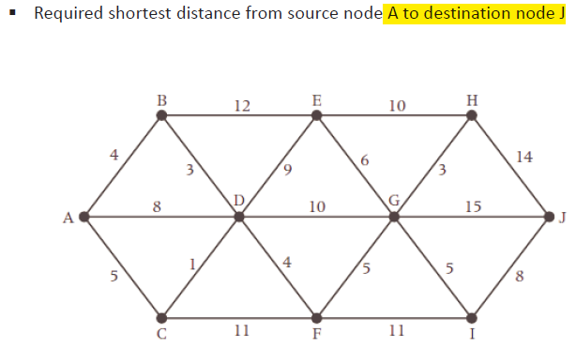
Dijkstra’s Shortest Paths Algorithm, Contd.
Example

Slide 15
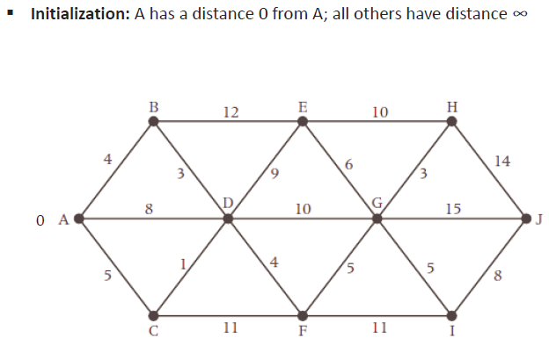
Dijkstra’s Shortest Paths Algorithm, Contd.

Slide 16
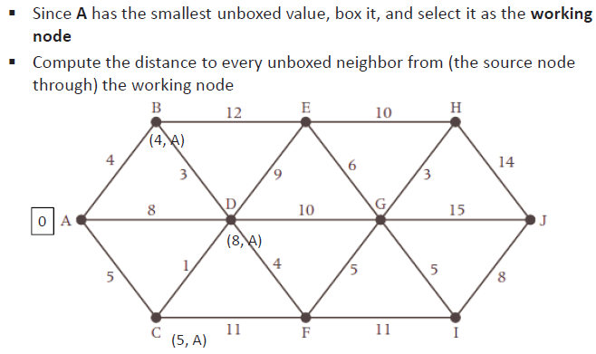
Dijkstra’s Shortest Paths Algorithm, Contd.

Slide 17
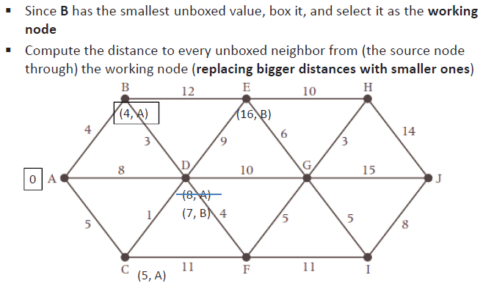
Dijkstra’s Shortest Paths Algorithm, Contd.
B has the smallest distance from A and no future path from A to B can be shorter and so it is final

Slide 18
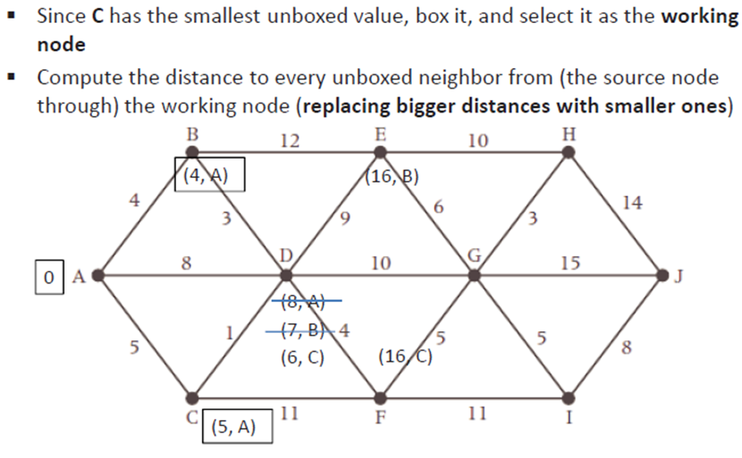
Dijkstra’s Shortest Paths Algorithm, Contd.

Slide 19
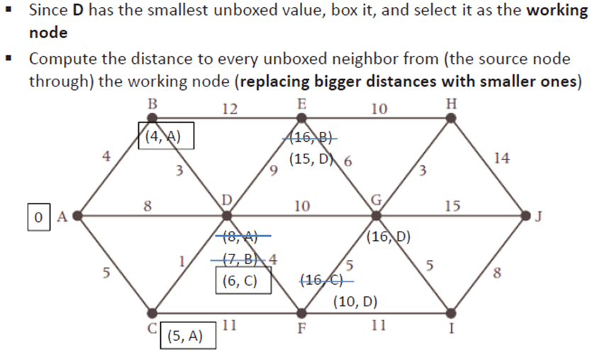
Dijkstra’s Shortest Paths Algorithm, Contd.

Slide 20
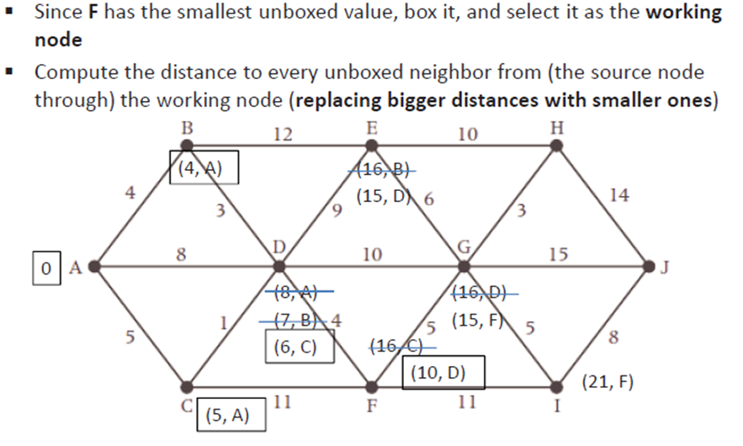
Dijkstra’s Shortest Paths Algorithm, Contd.

Slide 21
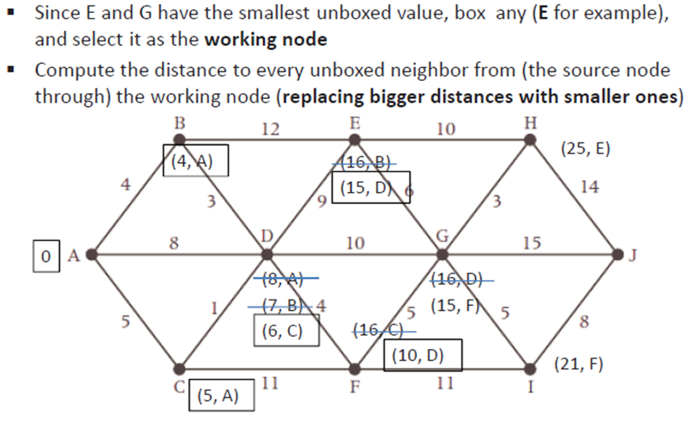
Dijkstra’s Shortest Paths Algorithm, Contd.

Slide 22
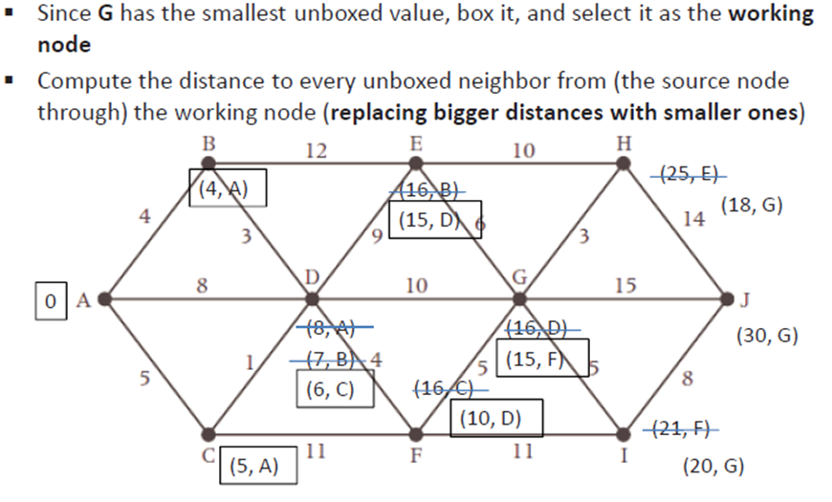
Dijkstra’s Shortest Paths Algorithm, Contd.

Slide 23
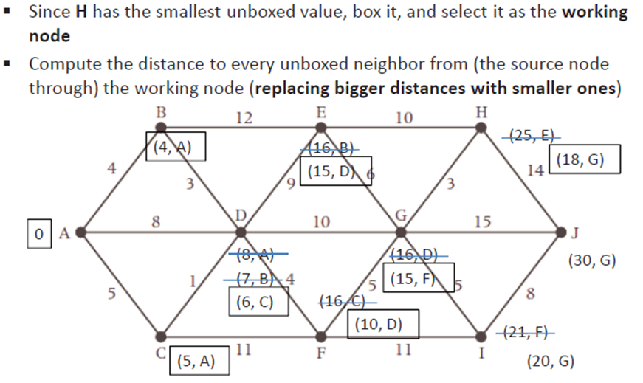
Dijkstra’s Shortest Paths Algorithm, Contd.

Slide 24
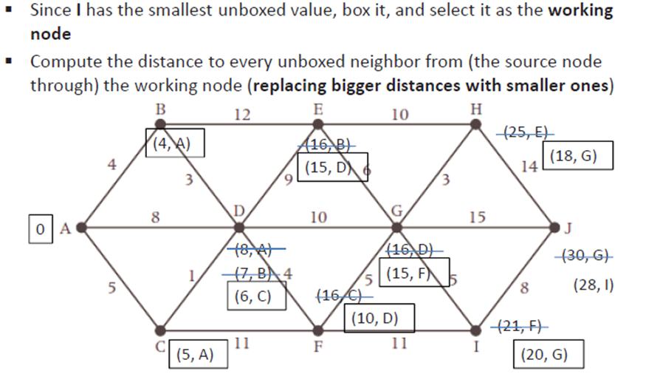
Dijkstra’s Shortest Paths Algorithm, Contd.

Slide 25
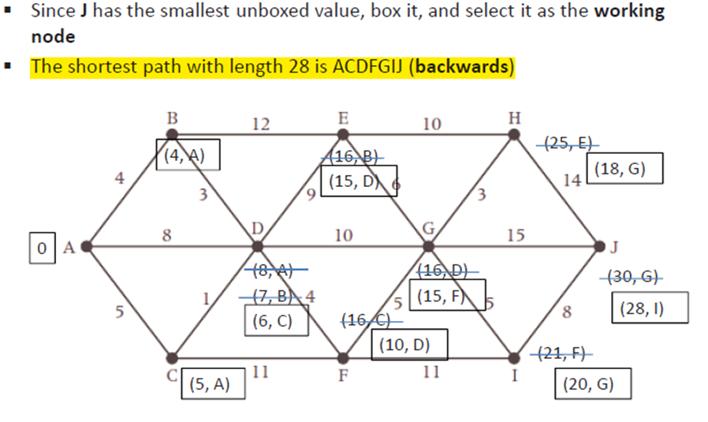
Dijkstra’s Shortest Paths Algorithm, Contd.

Slide 26
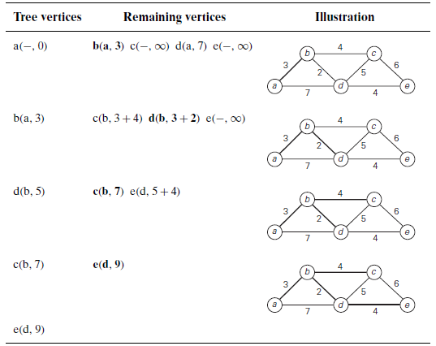

Dijkstra’s Shortest Paths Algorithm, Contd.
Boxed
Example
26

Slide 27
Dijkstra’s Shortest Paths Algorithm, Contd.
Dijkstra’s algorithm
Among vertices not already in the tree, it finds vertex u with the smallest sum
d_{v} + w(v,u)
where
v is a vertex for which shortest path has been already found on preceding iterations (form the tree root s)
d_{v} is the length of the shortest path from source s to v w(v,u) is the length (weight) of edge from v to u
It always ends up with single-source shortest paths to all destinations
because a boxed vertex has the shortest current distance from the source and no other future such path can be shorter
Notes:
In the single-source shortest paths problem, the goal is to find the shortest paths from a specified starting vertex (called the source) to all other vertices in a graph.

Slide 28
Dijkstra’s Shortest Paths Algorithm, Contd.
Correctness can be proven by induction on the number of vertices
Applicable to both undirected and directed graphs
Cannot be adopted for graphs with negative weights (whereas Floyd’s algorithm does, as long as there is no negative cycle).
Can you find a counterexample for Dijkstra’s algorithm?
Efficiency
O(|V|²) for graphs represented by weight matrix and array implementation of priority queue
O(|E| log |V|) for graphs represented by adjacency lists and min-heap implementation of priority queue
We prove the invariants: (i) when a vertex is added to the tree, its correct distance is calculated and (ii) the distance is at least those of the previously added vertices
https://kgardner.people.amherst.edu/courses/s19/cosc211/handouts/dijkstra_slides.pdf; https://avivt.github.io/avivt/downloads/tutorials/Class3.pdf
Notes:
No negative cycles; a negative cycle will always be a problem
● In fact, no negative edges; a negative edge will sometimes be a problem

Slide 29
Coding Problem
Coding
assignment of bit strings (codewords) to alphabet characters
e.g., we can code {a,b,c,d} as {00,01,10,11} or {0,10,110,111} or {0,01,10,101}
Two types of codes
fixed-length encoding (e.g., ASCII)
variable-length encoding (e.g., Morse code)
Prefix-free codes (or prefix-codes)
no codeword is a prefix of another codeword
It allows for efficient (online) decoding!
e.g., consider the encoded string (msg) 10010110…
e.g., if P(a) = 0.4, P(b) = 0.3, P(c) = 0.2, P(d) = 0.1, then the weighted average length of this code is 1*0.4 + 2*0.3 + 3*0.2 + 3*0.1 = 1.9 bits
Notes:
P(); These probabilities indicate how frequently each character appears in the message.
Prefix-free codes :
This means that if one codeword is 100, no other codeword in the set can start with 100 (i.e,10010)
Since no codeword is a prefix of another, decoding can be done as soon as each codeword is encountered.

Slide 30
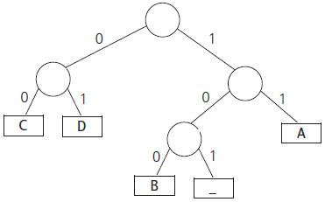
Coding Problem, Contd.
A binary prefix code can be represented by a binary tree
associate the alphabet’s symbols with the leaves of the binary tree
each left edge is labeled by 0 and each right edge is labeled by 1
and the codeword of a symbol can then be obtained by recording the labels on the simple path from the root to the symbol’s leaf
0
1
0
1
1
represents {00, 011, 1}
30
Notes:
Simple path (graph theory), a simple path is a path in a graph which does not have repeating vertices

Slide 31
Coding Problem, Contd.
If frequencies of the character occurrences are known, what is the best binary prefix-free code?
The one with the shortest average code length
representing on the average how many bits are required to transmit or store a character
Huffman code
represented by a Huffman tree
that would assign shorter bit strings to high-frequency symbols
and longer ones to low-frequency symbols
by the greedy Huffman algorithm invented by David Huffman while he was a graduate student at MIT
31

Slide 32
Huffman Codes
Huffman Algorithm
Initialize n one-node trees and label them with the characters of the alphabet
Record the frequency of each character in its tree’s root to indicate the tree weight
the weight of a tree is equal to the sum of the frequencies in the leaves
Repeat n-1 times the following until a single tree is obtained
Find two trees with the smallest weight
Join them as left and right subtrees of a new tree and record the sum of their weights in the root of the new tree as its weight
Mark edges leading to left and right subtrees with 0 and 1 respectively

Slide 33
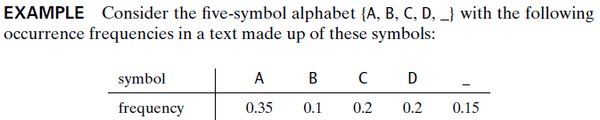

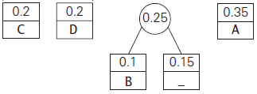

Huffman Codes, Contd.
Example
initialization
forming a tree out of the two trees with smallest weight
two trees with smallest weight

Slide 34
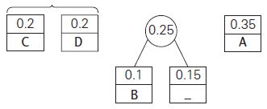
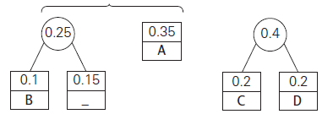
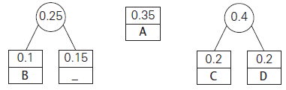
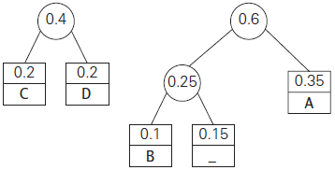
Huffman Codes, Contd.
two trees with smallest weight
two trees with smallest weight
forming a tree out of the two trees with smallest weight
forming a tree out of the two trees with smallest weight

Slide 35
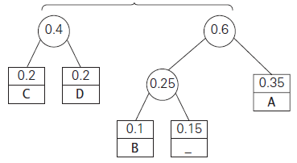
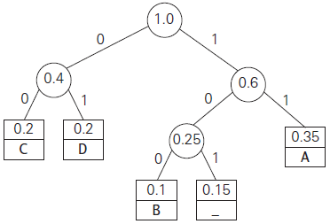

Huffman Codes, Contd.
two trees with smallest weight
forming a tree out of the two trees with smallest weight
Weighted average bits per character for variable-length encoding: 2.25 bits
For fixed-length encoding: 3 bits.
The compression ratio measures the savings achieved by using variable-length encoding compared to fixed-length encoding
Compression ratio: (3-2.25)/3*100% = 25%

Slide 36
Questions?

